Slide 1


Student Details
Name : RAYALA POOJASREE
Reg No: AP22110010624
Skills build email id: poojasree_Rayala@srmap.edu.in
College name: sRm university ap
College state : Andhra Pradesh
Internship domain: cyber security using kali linux
Start date and end date::07/06/2024 - 12/07/2024

Slide 2
Image steganography
Image steganography is a technique used to conceal secret information within digital images, making it imperceptible to the human eye. Unlike cryptography, which scrambles the content of the message to protect its confidentiality, steganography hides the very existence of the message, adding an extra layer of security.

Slide 3
AGENDA
The goal of image steganography is to securely and discreetly conceal secret information within an image file, making the hidden data imperceptible to the human eye while ensuring that it can be retrieved accurately by the intended recipient. This involves embedding data in a way that maintains the visual integrity of the image while allowing for the covert transmission of information, protecting it from unauthorized detection and potential interception.

Slide 4
PROJECT OVERVIEW
PURPOSE: The image steganography project aims to explore and implement techniques for hiding secret information within digital images. This project will involve understanding the principles of steganography, particularly focusing on methods for embedding data into images without noticeable changes to the human eye.
OBJECTIVE: The objective of image steganography involve:
Concealment: Embedding data within an image without significantly altering the image's appearance or quality.
Security: Ensuring the hidden information remains undetectable by common analysis techniques and protected from unauthorized access.
Integrity: Preserving the accuracy and completeness of the hidden data during embedding and extraction processes.

Slide 5
WHO ARE THE END USERS of this project?
The end users of image steganography encompass government agencies, military entities, journalists, corporate sectors, cybersecurity experts, researchers, law enforcement bodies, healthcare institutions, individuals, and developers of secure communication applications.

Slide 6
YOUR SOLUTION AND ITS VALUE PROPOSITION
Our image steganography solution provides a robust, user-friendly tool for embedding and extracting secret information within digital images. Leveraging advanced techniques like Least Significant Bit (LSB) modification the tool ensures high levels of security and imperceptibility.
VALUE PROPOSITION:
Enhanced Security: Safeguards sensitive information by embedding it within images, making it invisible to unauthorized observers and resistant to steganalysis attacks.
High Imperceptibility: Maintains the visual quality of the host images, ensuring that the embedded information is undetectable to the human eye.
Versatility: Compatible with various image formats and resilient against common image manipulations such as resizing, cropping, and compression.

Slide 7
How did you customize the project and make it your own
I've tailored the image steganography project to meet the needs of security experts, government agencies, and businesses by designing it with flexible features that adapt to varying levels of data sensitivity. This ensures the system is both practical and versatile. It employs advanced algorithms to enhance data security, making it more robust and efficient in handling image processing operations. The system has been rigorously tested and validated through real-world scenarios and user feedback to ensure it meets the users' specific requirements and addresses their unique challenges effectively.

Slide 8
MODELLING
SYSTEM ARCHITECTURE :
Input Module : Accepts image files and secret data from the user.
Preprocessing Module : Validates the input image and data.Prepares the image for data embedding (e.g., resizing, format conversion).
Embedding Module : Implements the steganographic algorithm to hide the secret data within the image.
Post-processing Module : Applies any necessary post-embedding modifications (e.g., compression, encryption).Outputs the stego image.
e. Extraction Module : Extracts hidden data from the stego image. Validates the integrity and accuracy of the extracted data.

Slide 9
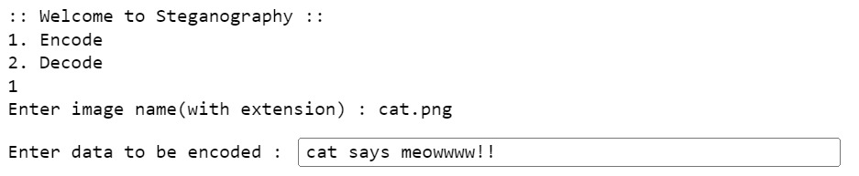
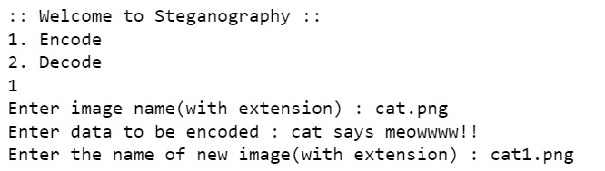
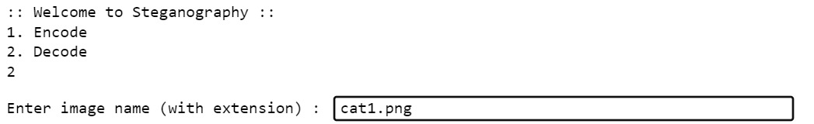
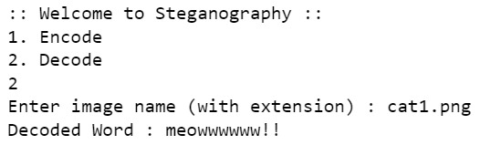
Results

Slide 10
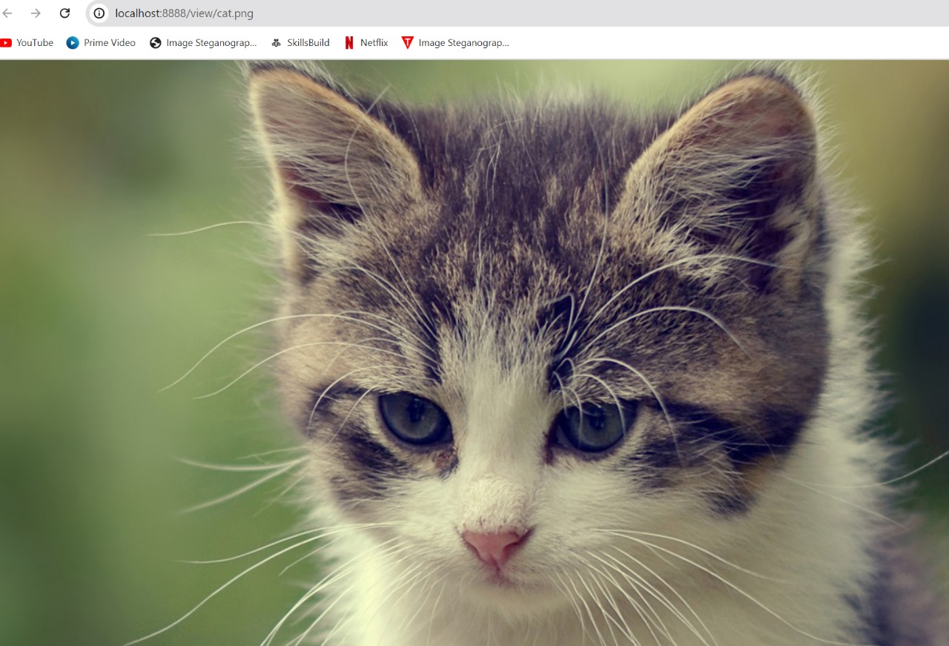
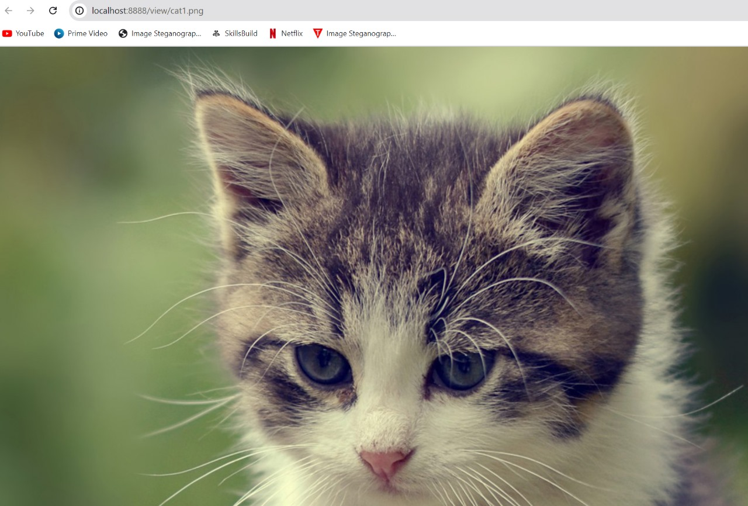
RESULTS

Slide 11
links
https://www.javatpoint.com/image-steganography-using-python
https://www.geeksforgeeks.org/image-based-steganography-using-python/

